Slide 1
ControlPoint Essentials Overview
Secure Content Management Suite

Slide 2

Agenda
Trends
Customer Challenges
Solution Capabilities
Value to Change
Customer Success
Summary

Slide 3
Trends

Slide 4
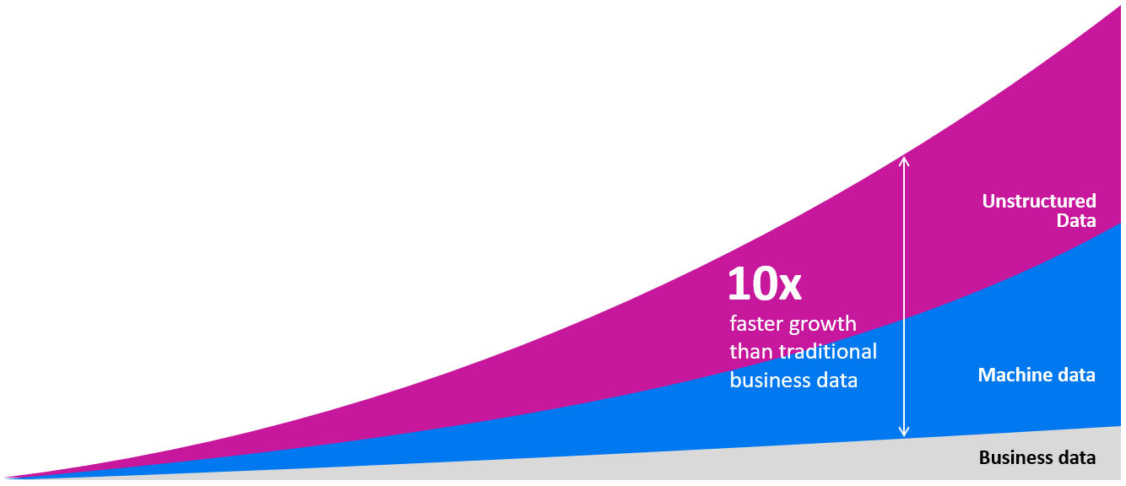
The data landscape has radically changed
More connected people, apps and things generating more data in many forms

Slide 5
Information Management inflection points
How big data is changing information value
Information Value is changing – organizations don’t understand what they have, where it lives, who owns it or its business context
Growing need to protect and retain all important information
Siloes
Retention
High risk & valuable information presents unique management challenges & costs - defensibly dispose or securely manage
Find-ability has an impact on business initiative and ability to deliver services and results
Find-ability
Cost
Global regulation driving lengthy and complex retention requirements and audit
Control

Slide 6
Customer Challenges

Slide 7
Giving rise to three recurring questions
Value
Risk
Cost
How do I get value from my enterprise information?
How do I secure content and reduce risk?
How do I reduce operational costs?
Too much data
No context or confidence
Delivers little insight
Dark data exists
Critical content in the wild
Ad-hoc policy application
Growing information footprint
Manual processes
Costs of information requests

Slide 8
Roles and Drivers
Managing information risk for regulatory compliance purposes
Identifying sensitive information such as PII, PHI and PCI
Management of information within the organization
Chief Compliance Officer
Chief Risk Officer
Identify information contained in unstructured data repositories
Produce information efficiently to reduce spend on outside counsel and eDiscovery.
Litigation Readiness
Chief Legal Officer
General Counsel
Lower IT operation costs
Efficient access to information
Control information footprint
IT Optimization and Productivity
Chief Information Officer

Slide 9
Solution Capabilities

Slide 10
ControlPoint
Identify, organize, control and manage unstructured data
Dispose ROT
Reduce
Archive
Leverage
Identify & index
Analyze
Organize
Declare
Understand
Get control
Manage-In-place
Manage & migrate
Mitigate risk
Migrate to Cloud

Slide 11
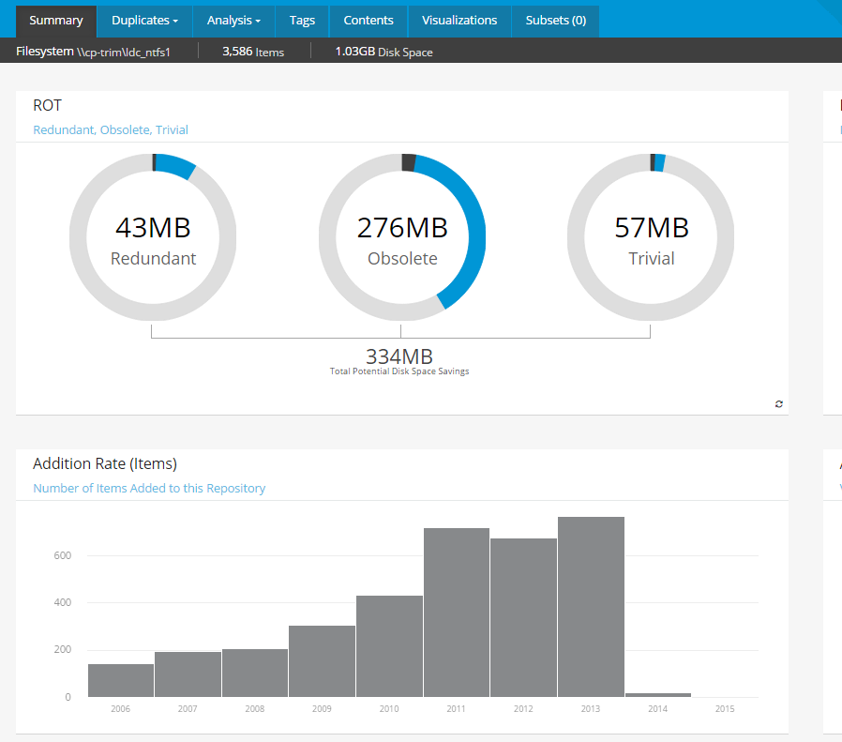
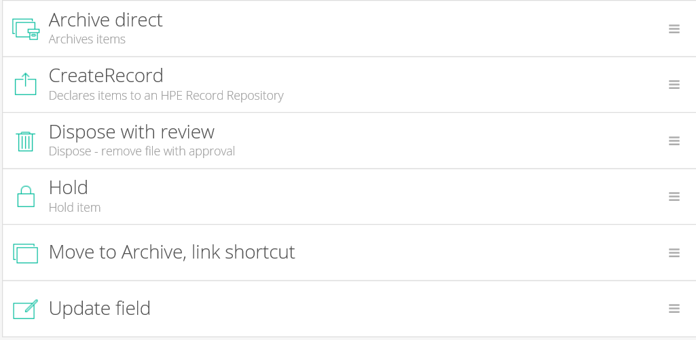
Identify and eliminate redundant, obsolete and trivial data
Capture metadata and/or content index from files
Build out-of-the box categorization reports
Review and tag
Execute actions to clean up data
Reduce data before migrating data to cloud

Slide 12

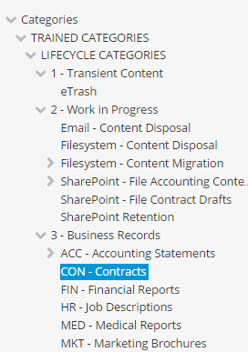
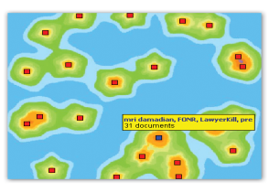
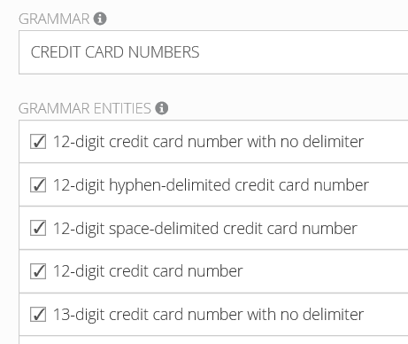


Identify and control business critical data across enterprise systems
Contracts
HR data
Identify sensitive data (pattern matching)
Auto-categorize (incl. machine learning)
Automate actions (Dispose, move, hold or auto-declare records)
Off balance
sheet transactions
Product issues

Slide 13
Value to Change

Slide 14
ControlPoint Delivers Many Benefits
Policy based, object-level management and retention
according to business value.
Enhanced business insight
40% improvement in analysis review & reporting time
Optimized systems & storage
~60% reduction in tier 1
Reduced Cost & Risk
~40% for
storage operations & legal exposure
Improved compliance & security

Slide 15
Customer Success

Slide 16

East Gippsland Water
The Challenge
The Requirements
The Solution
  Reduce time to find records (normally hours)
  Ensure compliance with privacy laws and data regulations
  Identify sensitive business information
  Reduce the amount of dark data
  Control Point
Decreased data footprint by 30 percent, slowing growth in storage costs
Identified an additional 10% of its data that should be stored in a record-keeping system.
Reduced the time taken to find records, from hours to seconds.
Notes:
East Gippsland Water is a government corporation that supplies water services to 25,700 customers, and waste water services to 21,900 customers in the Australian state of Victoria. It services thousands of square miles, as well as managing millions of dollars of water treatment plants and other facilities.
East Gippsland Water faced a scenario familiar to many businesses and government bodies around the world — a growing volume of data, rising storage costs, and difficulty finding information quickly. Locating information involved searching network and desktop drives. This included numerous hours spent sifting through documents created in previous decades by several other water corporations and shire councils, which later merged with East Gippsland Water.
Instead of taking hours to search network drives, employees can type in keywords and find a record within seconds.
By using ControlPoint to identify data that could be deleted, the corporation was able to reduce its data footprint by 30 percent. This allowed it to postpone the purchase of additional storage hardware.
Using ControlPoint, the corporation has identified another 10 percent of its data that should be stored in a record-keeping system.

Slide 17
Summary

Slide 18
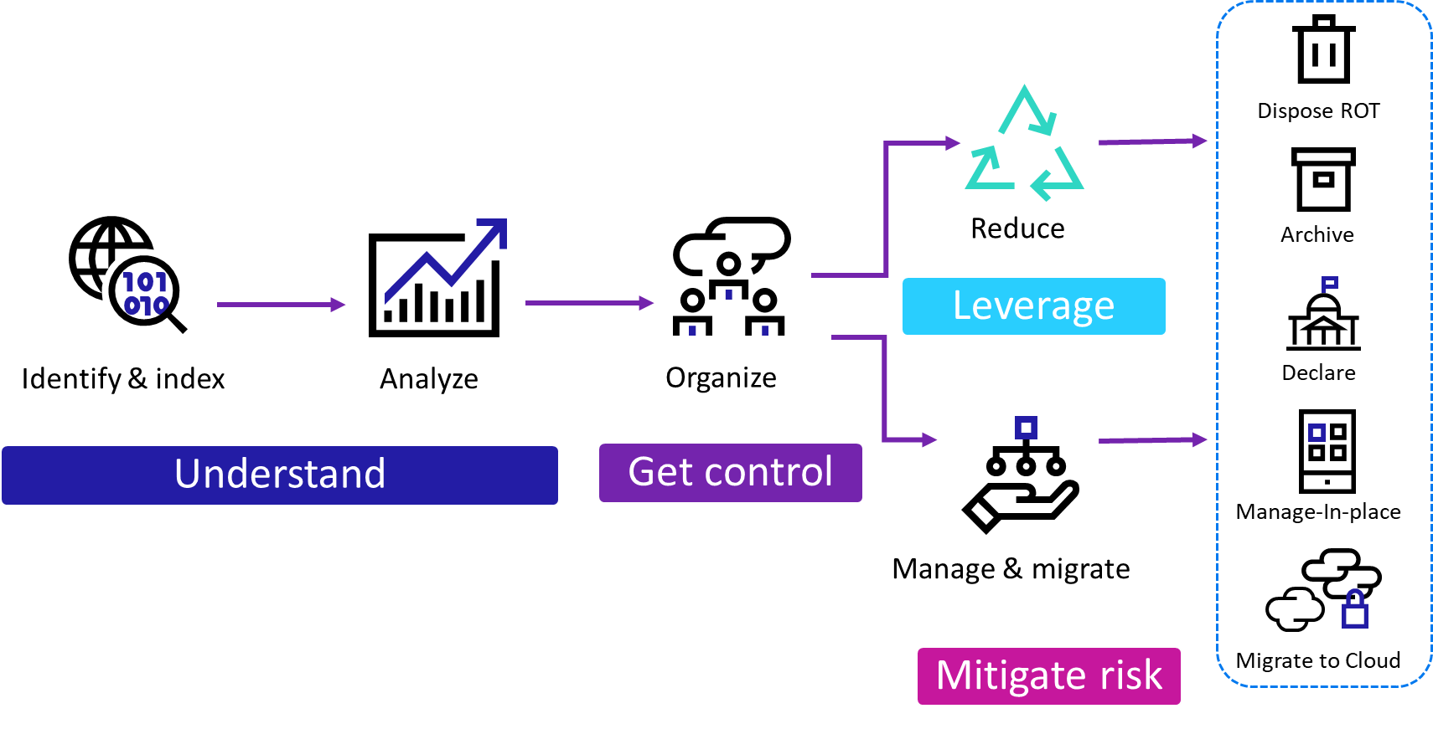
ControlPoint
identify, organize, control and manage unstructured data
Reduce storage costs
Reduce the time it takes to find information
Reduce risk by identifying sensitive business information
Understand all of your data
Gain value from your data

Slide 19
Secure Content Management Suite
Secure Content Management
ControlPoint
Content Manager
Structured Data Manager
Voltage
File & content analysis
Policy-Based Governance
Data archiving & application retirement
Data masking
Identification of personal data/
PII, PCI, PHI
ROT Analysis
Enterprise policy application
Manage-in-place
Security & access
Redaction
Retention
Disposition
Archiving
Reporting
Identification of sensitive data PII, PCI, PHI
Redaction (Voltage integration)
Encryption/ Decryption

Slide 20

Thank you

